Slide 1
For Editing the Gallery Images
Or any Images with 4:3 Aspect Ratio

Slide 2
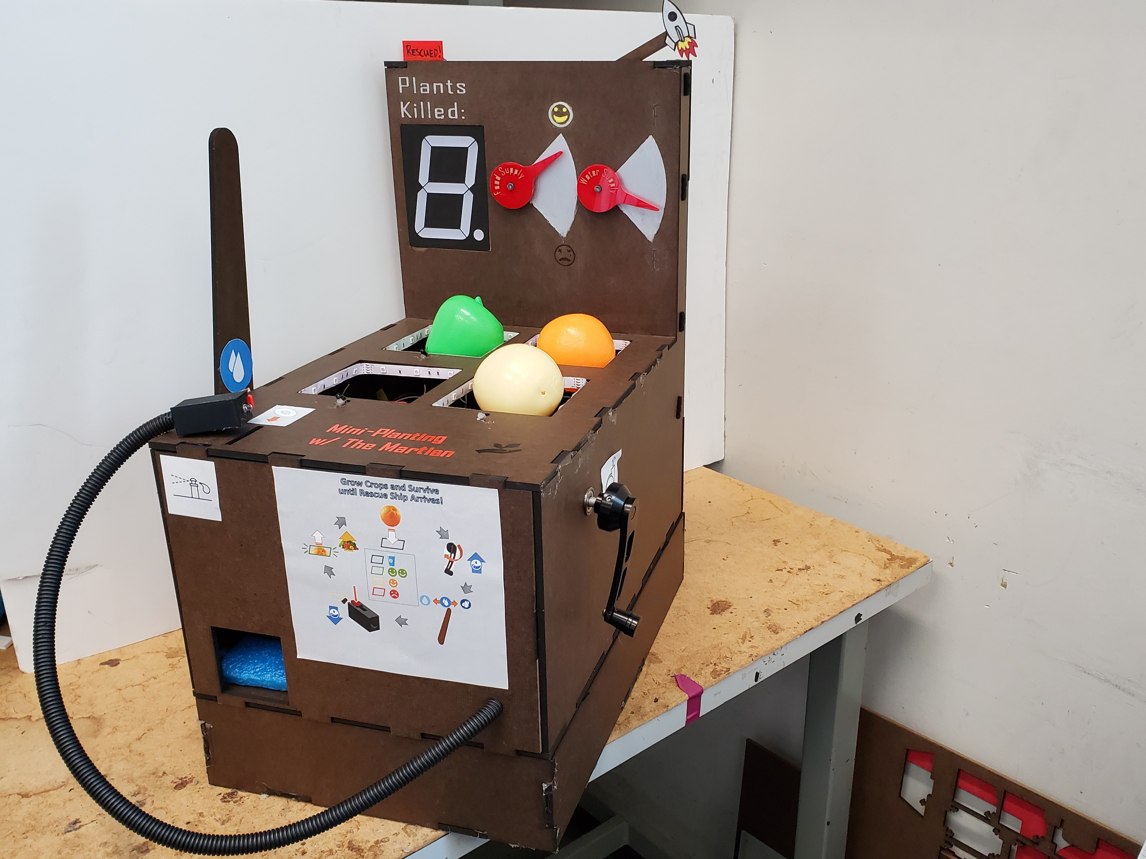
ME 218A Final Project

Slide 3
ME 218A: Smart Product Design
Applications
Final Project

Slide 4
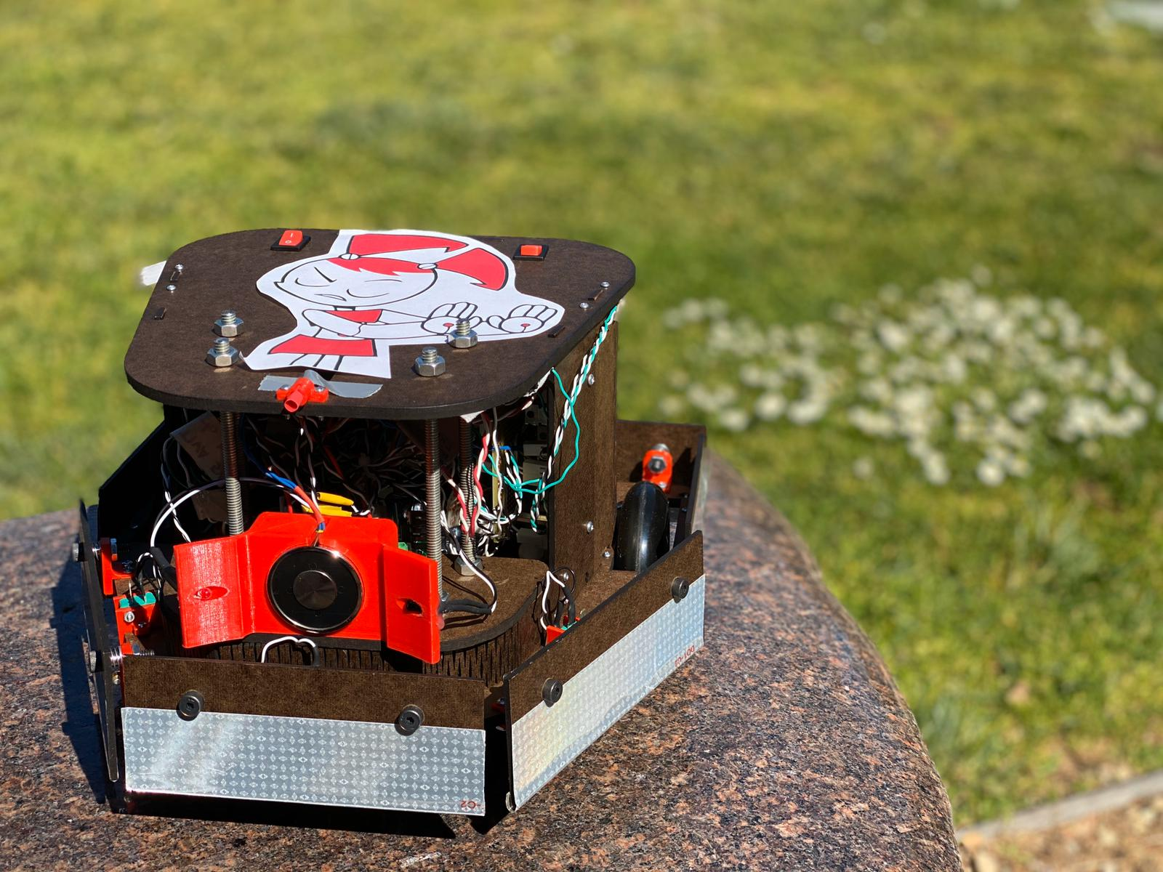
ME 218B Final Project

Slide 5
ME 218B: Smart Product Design
Applications
Final Project

Slide 6
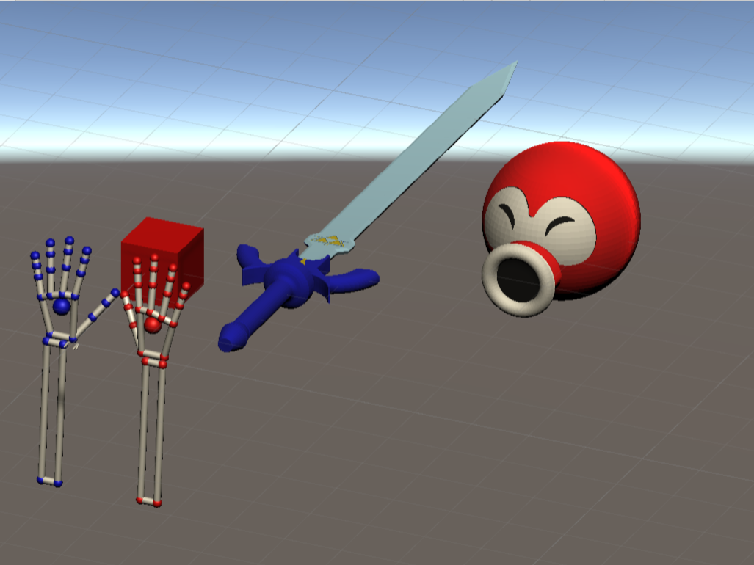
EE 267 Final Project

Slide 7
EE 267: Virtual Reality
Final Project

Slide 8
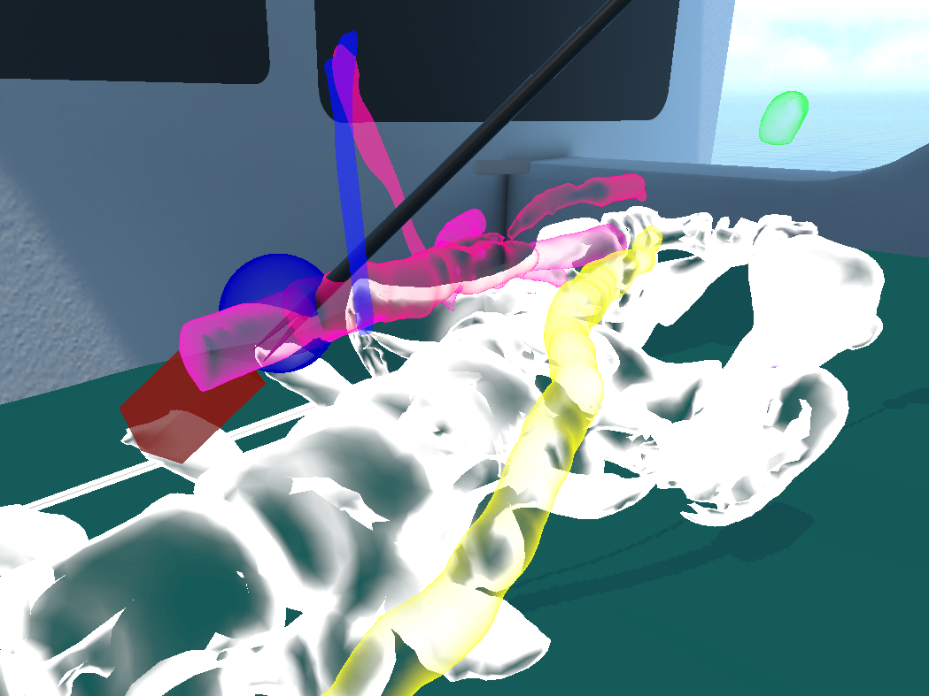
MARSS 2024 Hackathon

Slide 9
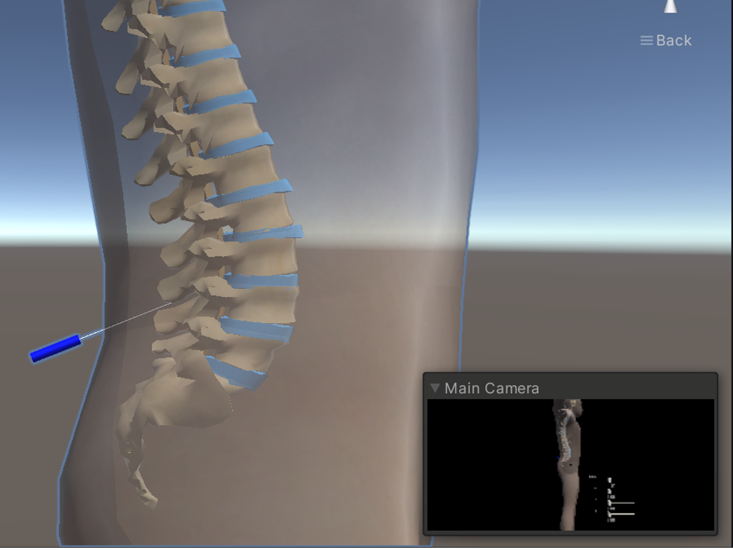
RAD 206 Final Project

Slide 10
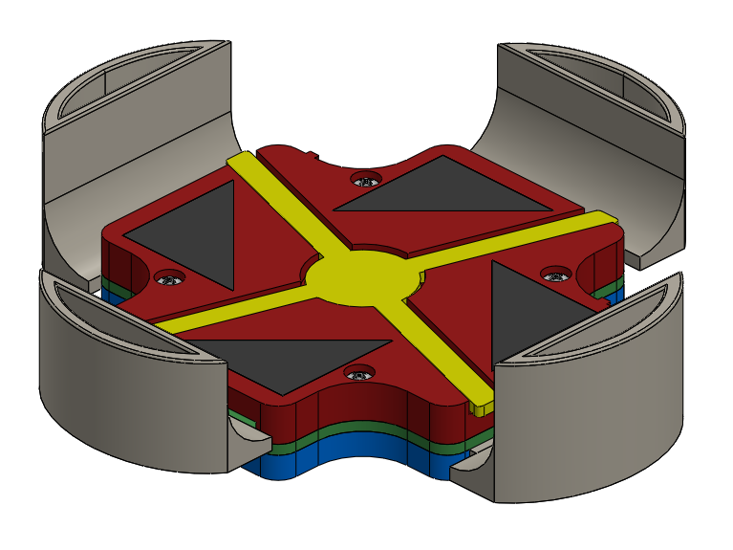
2.78 Final Project

Slide 11
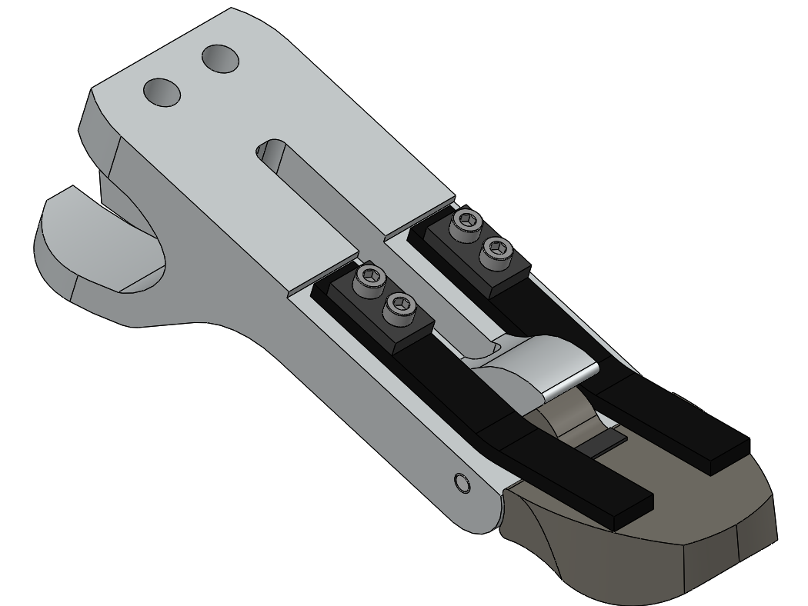
2.THU: Undergraduate Thesis

Slide 12
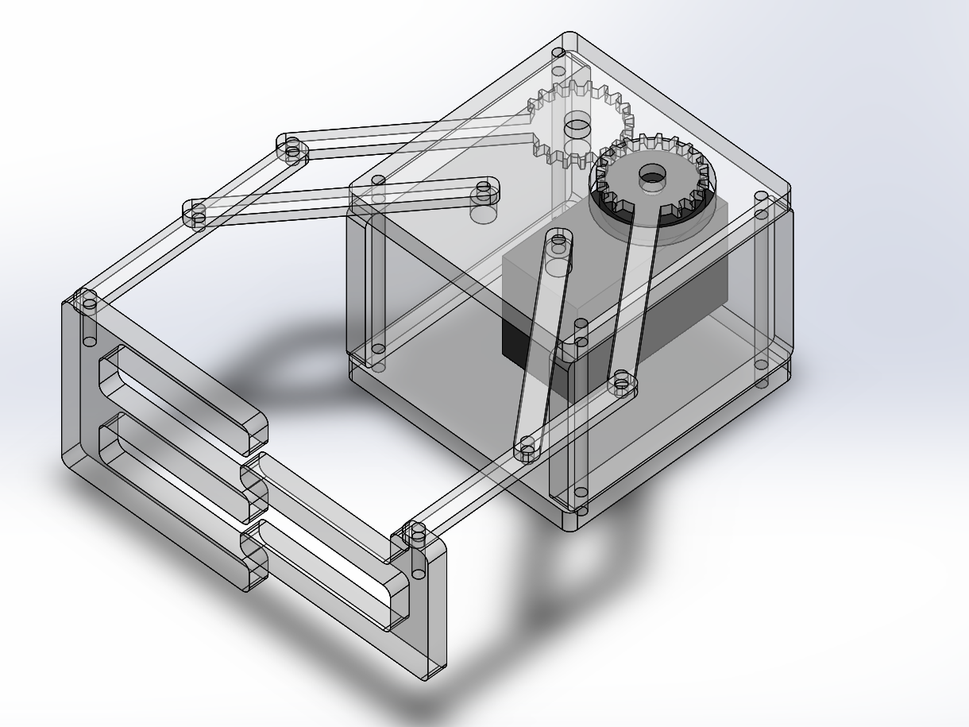
2.12 Introduction to Robotics Term Project

Slide 13
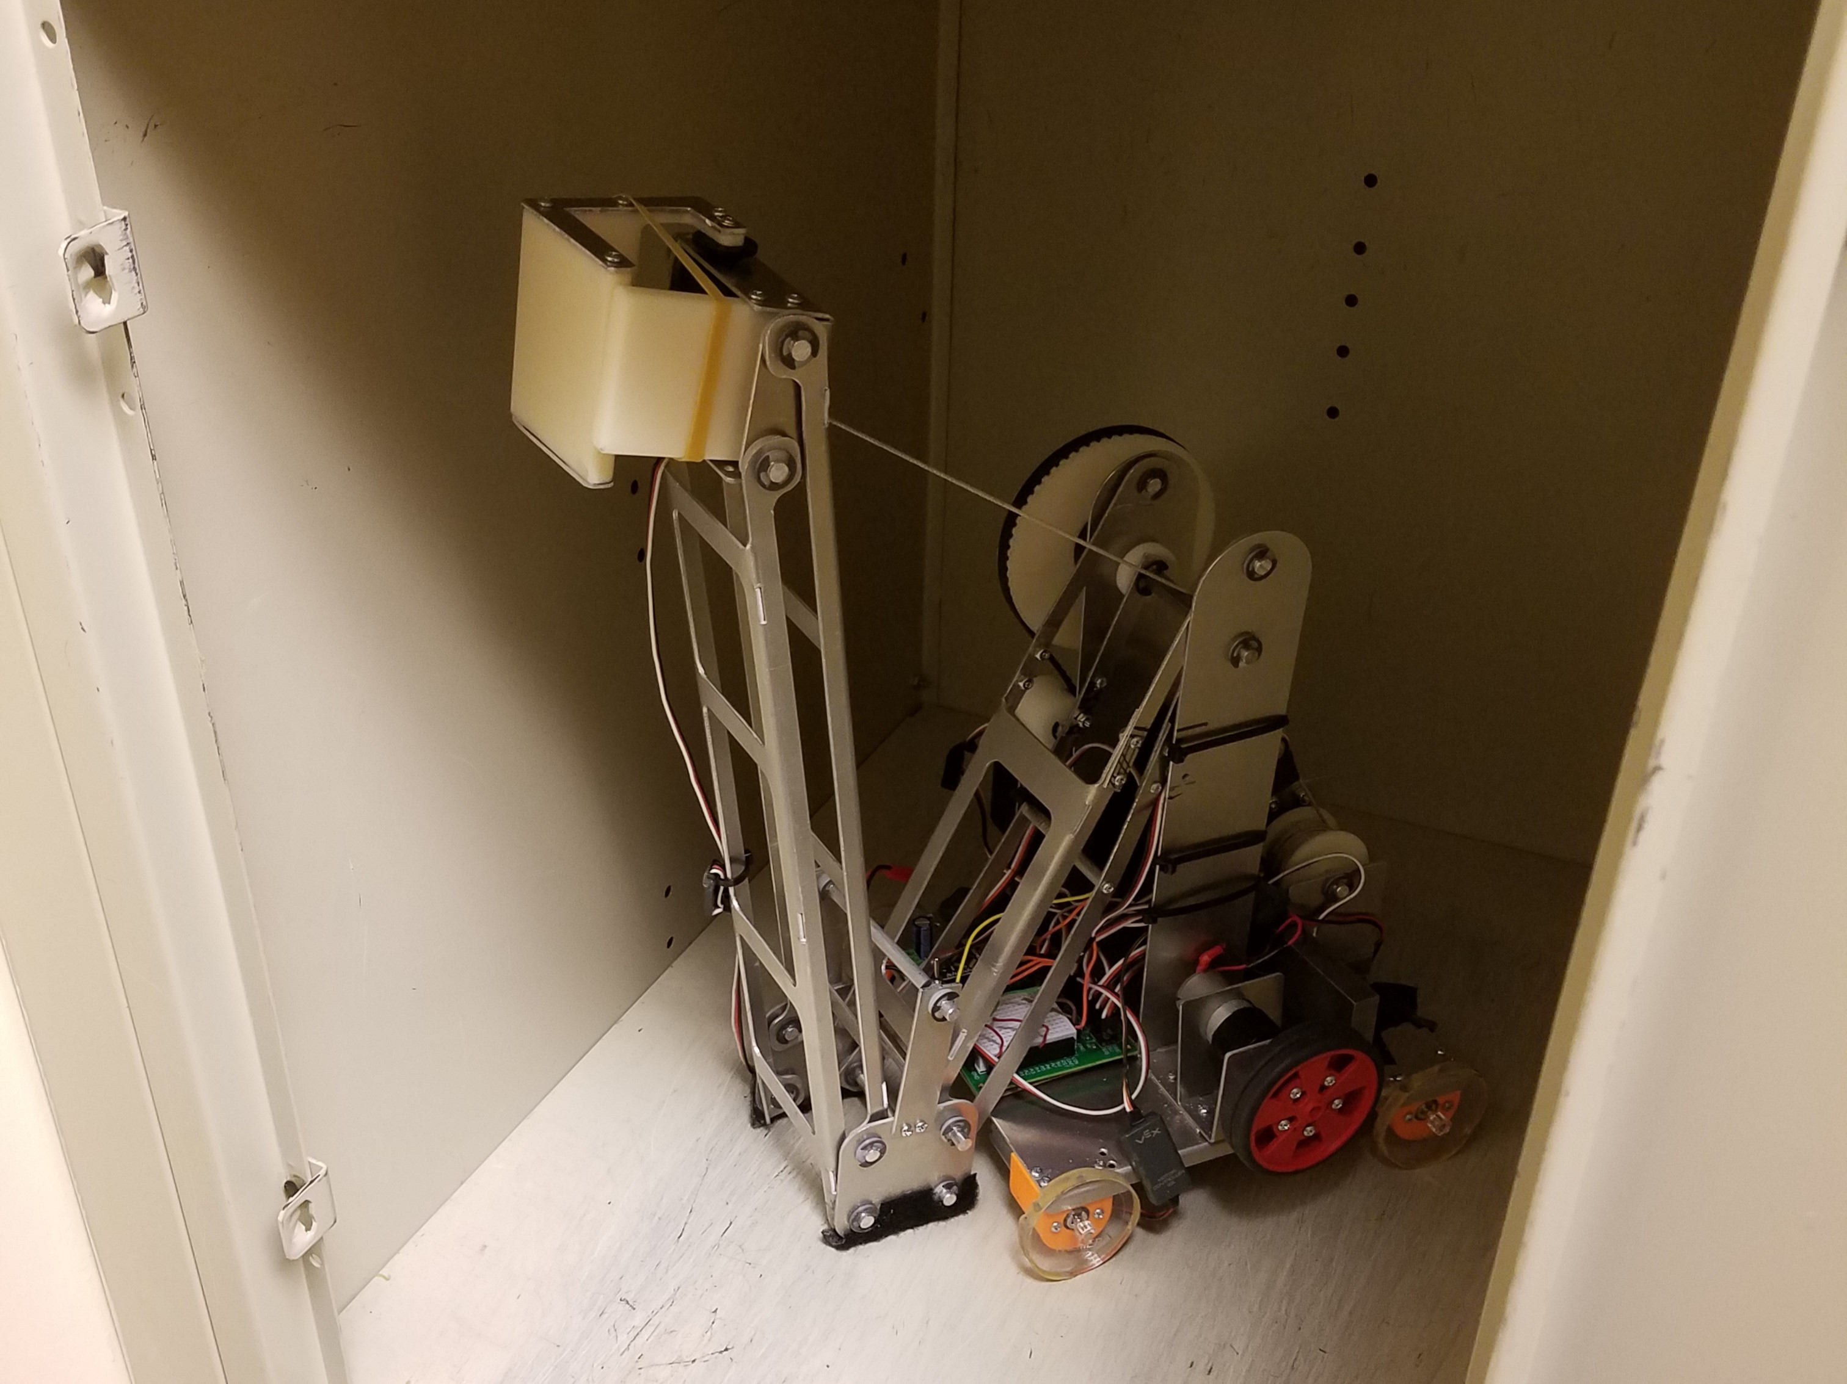
2.007 Design & Manufacturing I Final Project

Slide 14
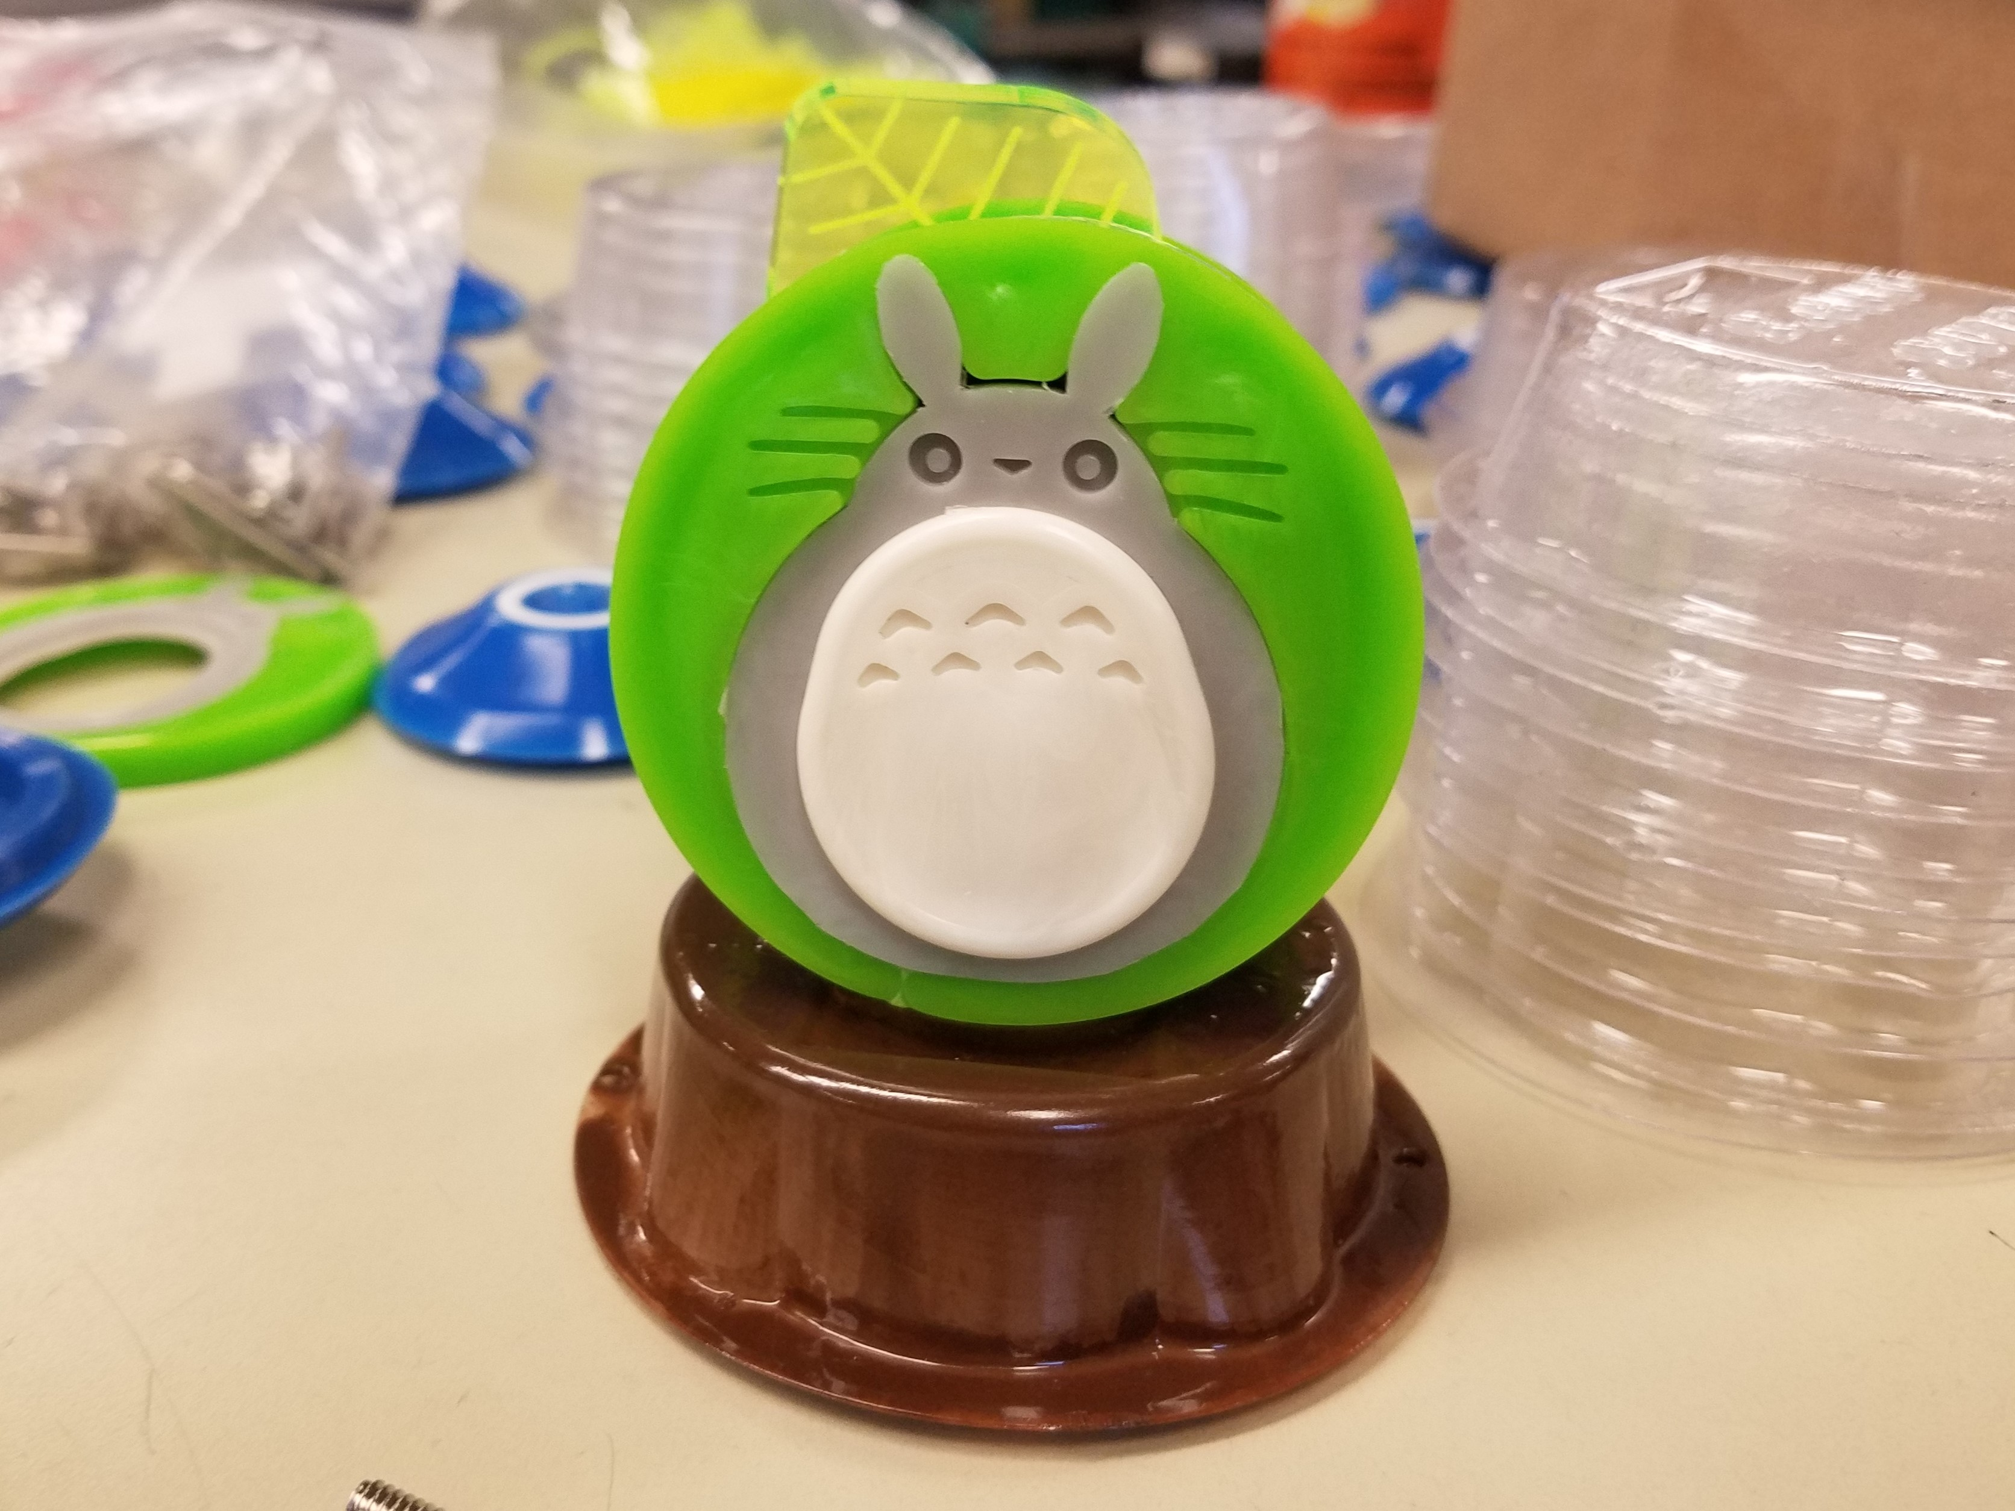
2.008 Design & Manufacturing II Final Project

Slide 15
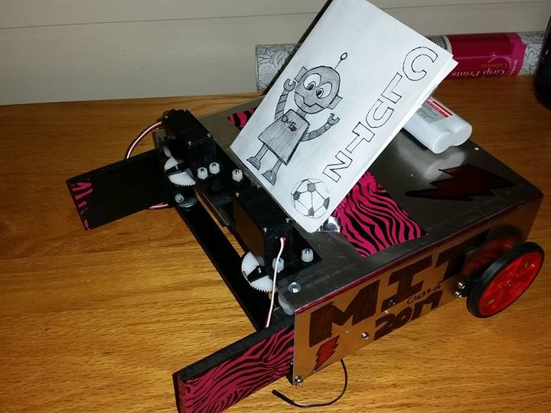
FPOP: Discovering Mechanical Engineering

Slide 16
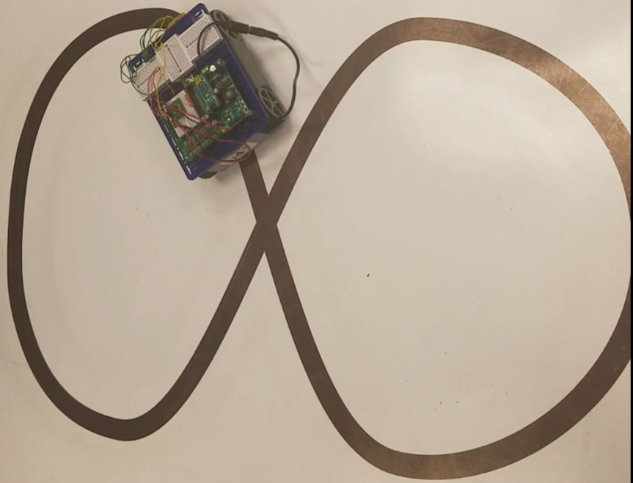
2.678 Electronics for Mechanical Systems Final Project

Slide 17





